Slide 1

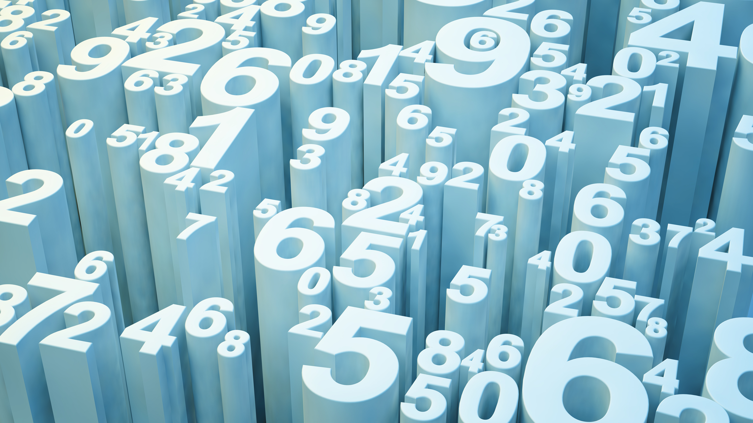
GENTRL Implementation
Sickle Cell Anemia

Slide 2
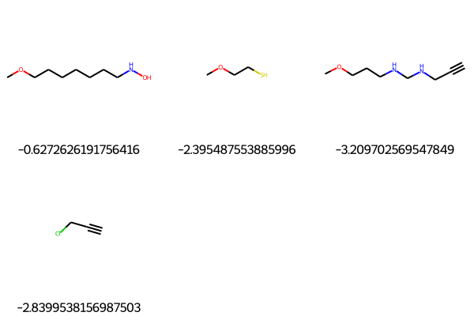
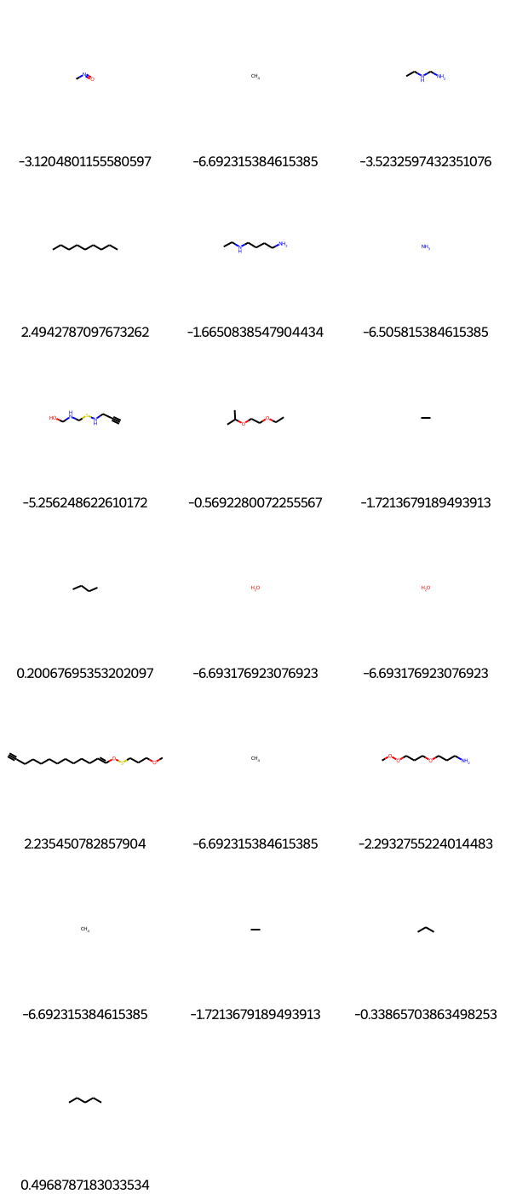
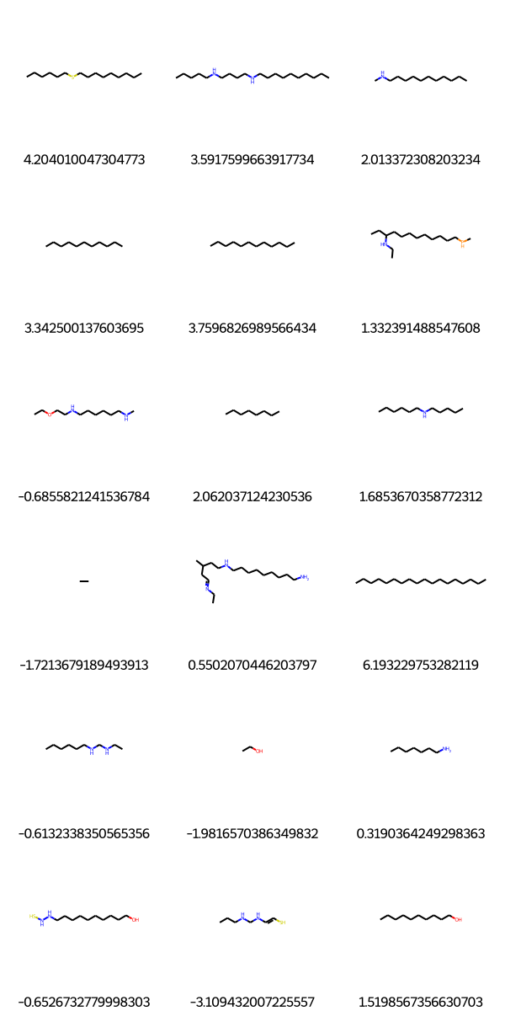
Val Accuracy :0.0507
Val Accuracy :0.22
Val Accuracy :0.117

Slide 3
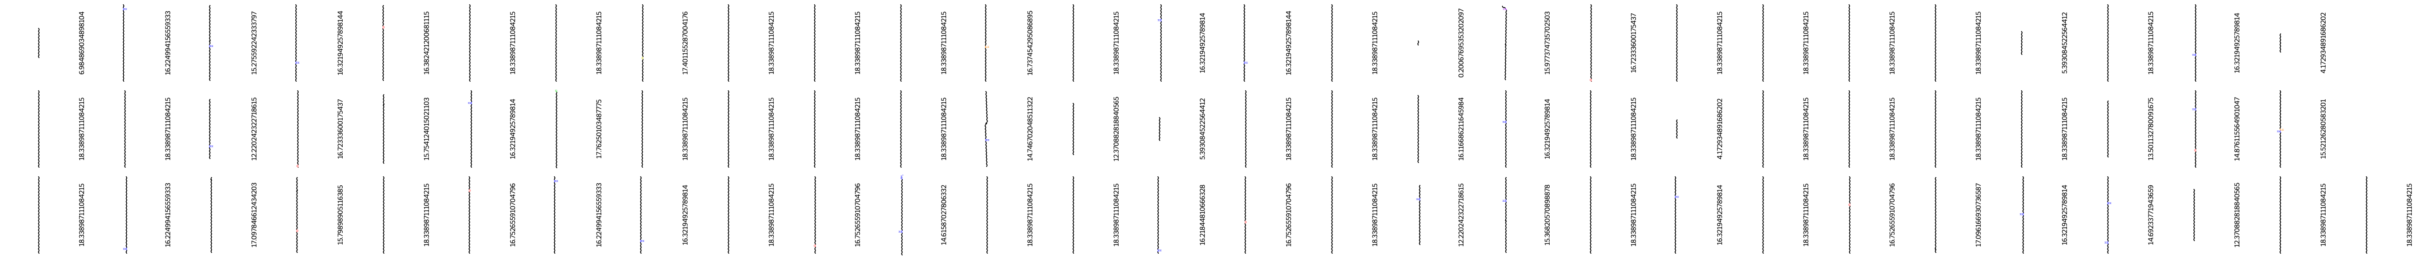

Val Accuracy :0.79
As the validation accuracy increases the model start too generate only one molecules
Val Accuracy :0.97

